Slide 1
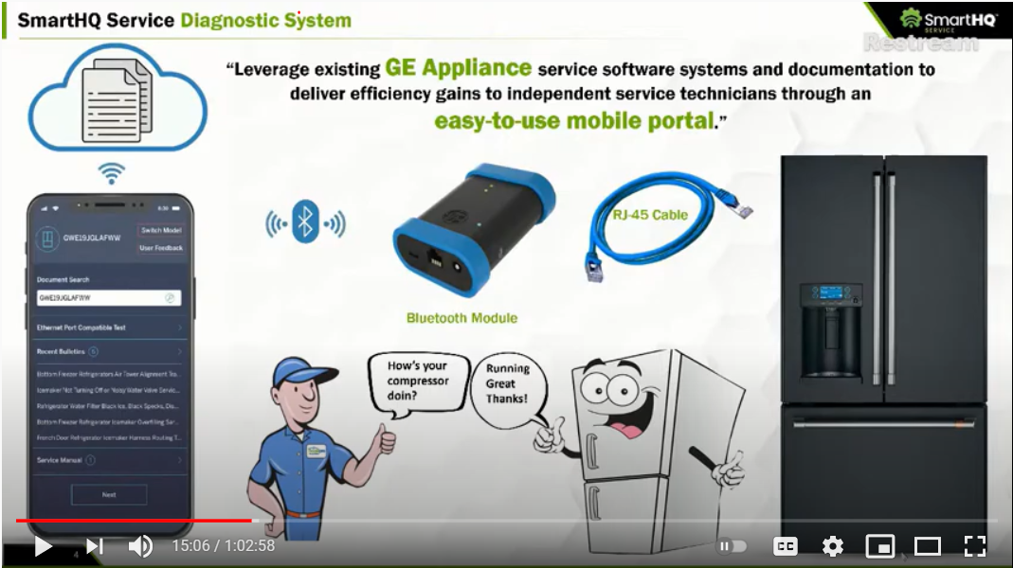
SmartHQ Service Diagnostic System
10/14/2025
9

